Slide 1
Automatic Modulation Classification
Name: Fahim Shahriar Talukder
ID: 1806193

Slide 2
Traditional Approaches
2 types of modulation classification:
Likelihood Based: Applying probability theories and hypothesis models to solve modulation identification problems under the conditions of known and unknown channel information
Feature Based: Extracting features from radio signal and then using different machine learning models

Slide 3
Deep Learning Base Approaches
All the previous works can be divided into 4 catagories
FFNN-based Model
RNN/LSTM based Model
CNN based Model
Hybrid Model

Slide 4
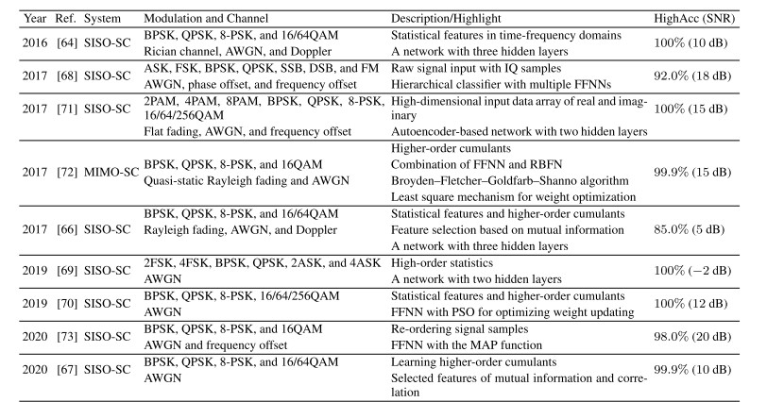
FFNN Based Previous Works

Slide 5
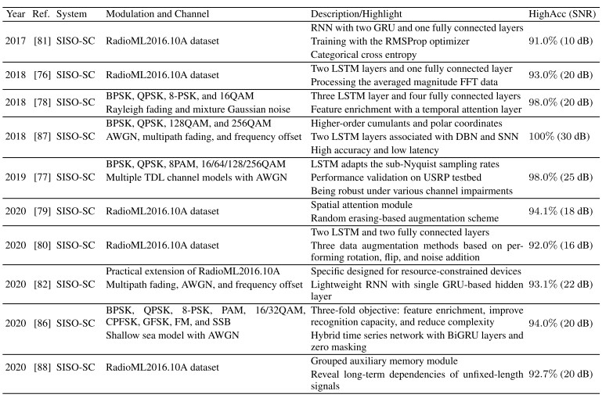

Slide 6
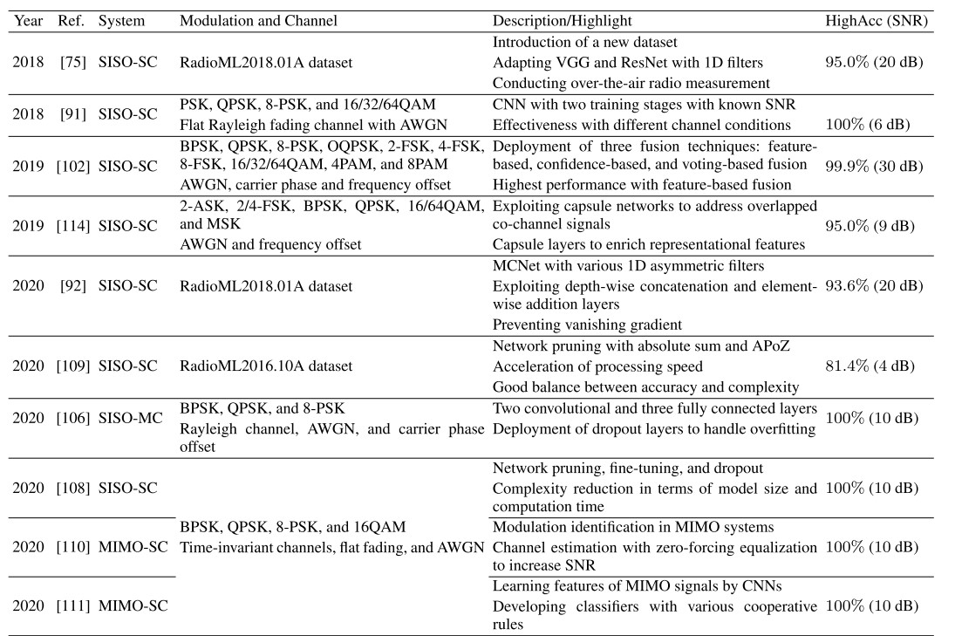

Slide 7
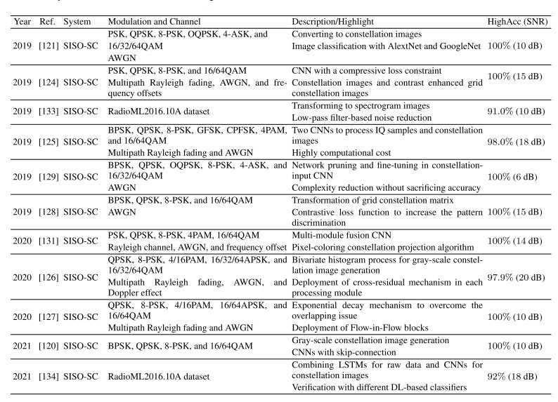

Slide 8
Work Done so Far
Simulated simpler architecture and observed the output
Here are the simulated results

Slide 13
Current Plan
Already the achieved accuracy is nearly 100% for higher SNR
Accuracy in low snr are significantly low
Plan is to work on lower SNR

Slide 14
Robust Automatic Modulation Classification in Low Signal to Noise Ratio
This paper was published in 2023
Here a special noise reduction technique is used
Uses TAD denoiser to denoise automatically
Threshold algorithm to denoise efficiently
Uses ResNet architecture for classification

Slide 15
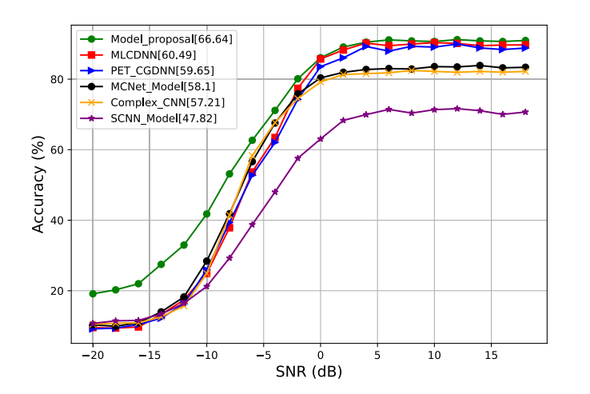
Accuracy of the paper

Slide 16
Current Plan
To recreate the paper
Try different classification algorithm like to improve the accuracy
Using the constellation diagram as the image input for classification
Trying to improve the noise reduction

